Slide 1
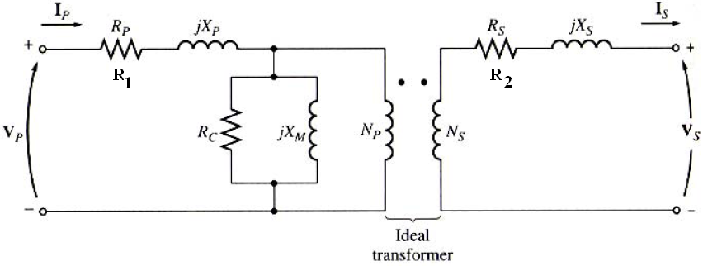
Transformer Modeling
The equivalent circuit

Slide 2
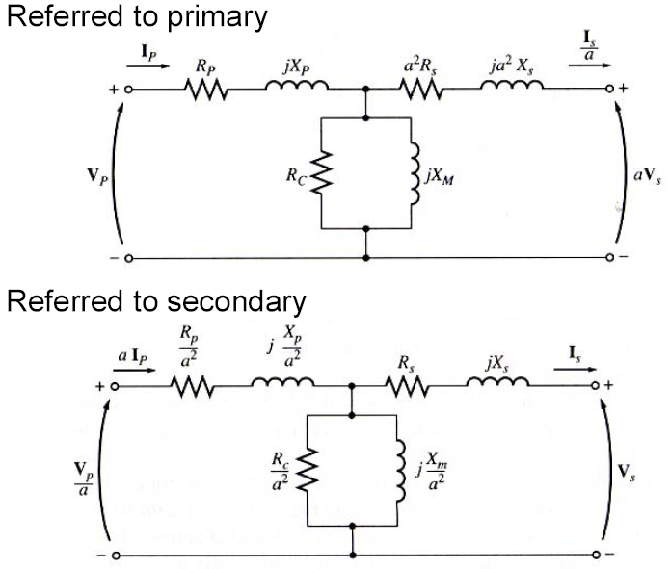
Transformer Modeling
The equivalent circuit

Slide 3
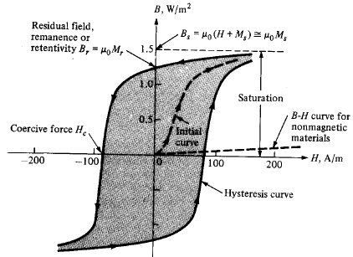
Magnetizing current
Recall the Hysteresis curve B versus H
At a sufficiently high H the core saturates and B is essentially constant.
The usual design principle is to have B = B_{sat} at the voltage peaks in the primary. (This minimizes the amount of iron needed in the core)

Slide 4
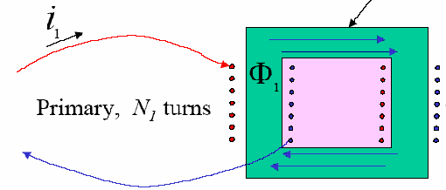
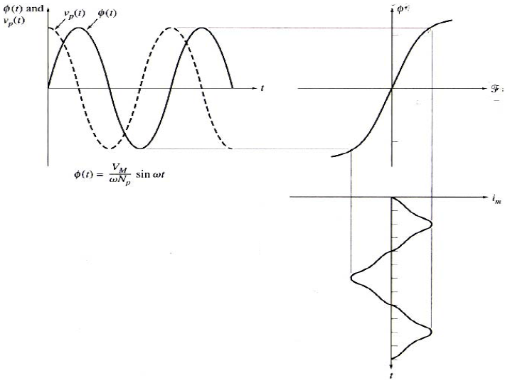
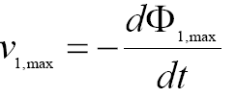

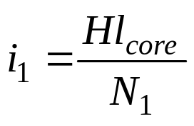
Magnetizing current
If v₁ goes beyond this range, however, H is above H_{sat}, and the effective inductance seen at the primary becomes small. The flux is also not well-confined to the core. Because of the reduced inductance, the current in the primary becomes large in these peak parts of the cycle.

Slide 5
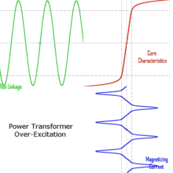
Magnetizing current

Slide 6
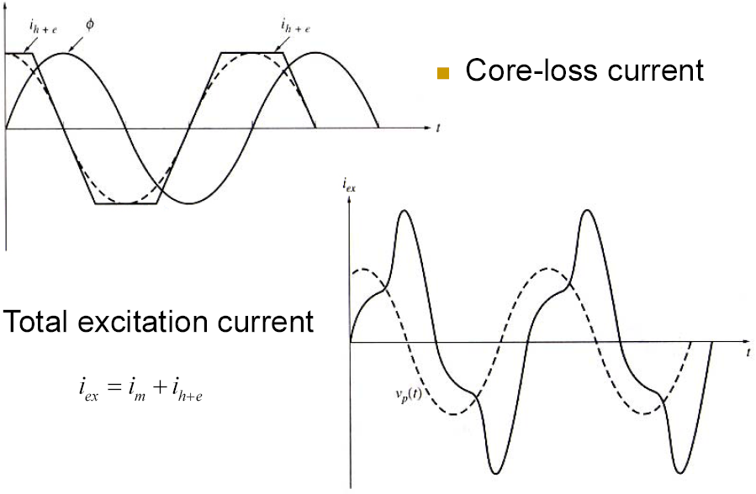
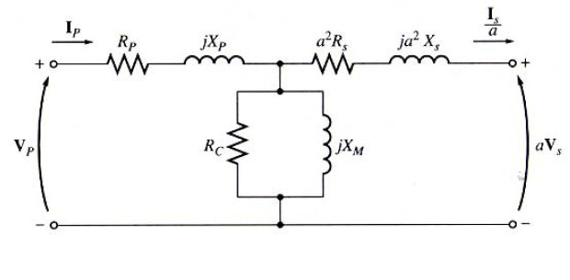
Excitation current

Slide 7
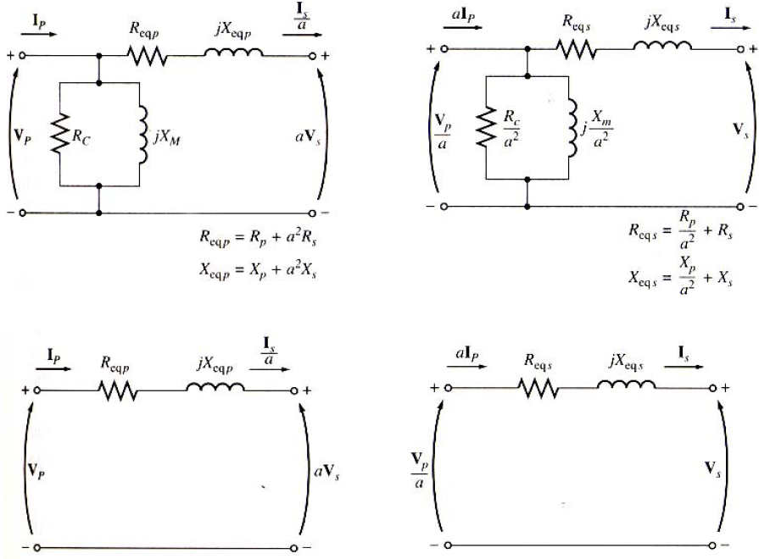
Transformer Modeling
Approximate equivalent circuits

Slide 8
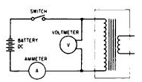
1-D.C. test
Determination of Equivalent Circuit
This test is carried out to measure the resistance of each winding
The resistance of each winding is obtained from the Ohms Law R = E/I

Slide 9
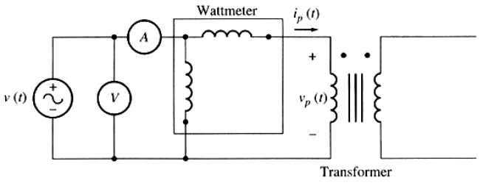
Determination of Equivalent Circuit
2- Open Circuit Test
The secondary winding is left open
The primary winding is connected to a full-rated voltage
Measure V, I, P
Want to find R_{C} and X_{M}

Slide 10
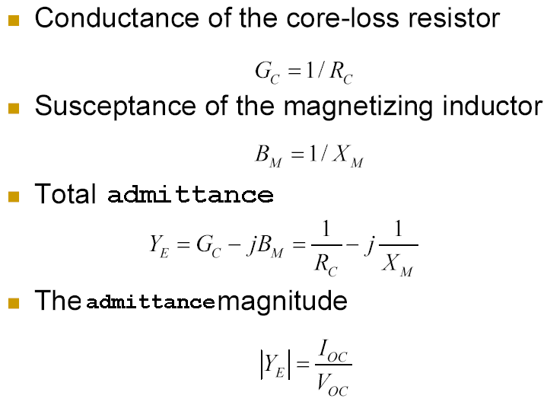
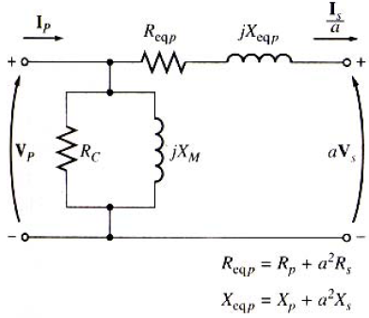
Determination of Equivalent Circuit
2- Open Circuit Test

Slide 11
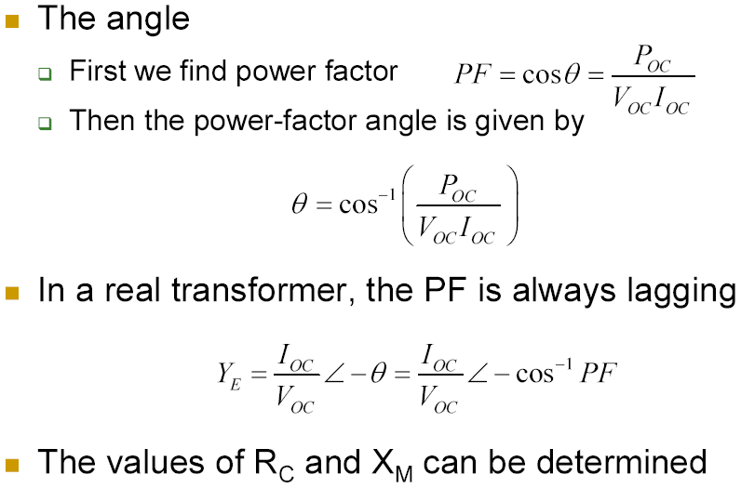
Determination of Equivalent Circuit
2- Open Circuit Test

Slide 12
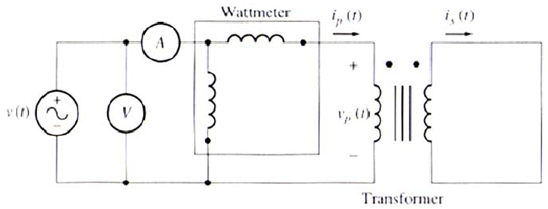
Determination of Equivalent Circuit
3- Short Circuit Test
The secondary terminals are shorted
The input voltage is adjusted until the current is equal to its rated value
Measure V, I, P
Want to find R_{eq} and X_{eq}

Slide 13
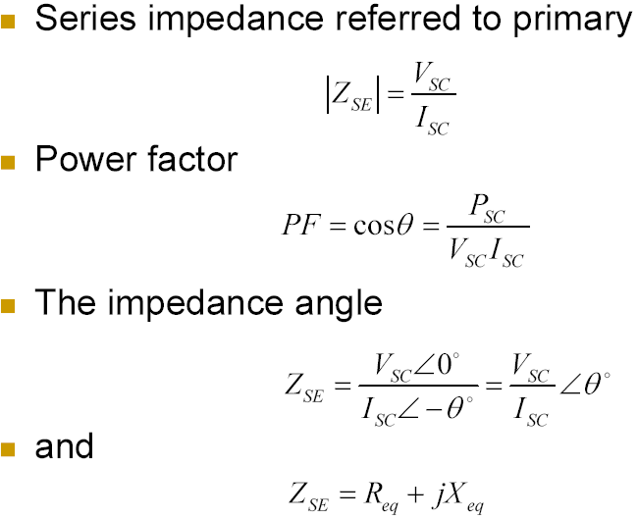
Determination of Equivalent Circuit
3- Short Circuit Test

Slide 14
Determination of Equivalent Circuit
Approximate equivalent circuits

Slide 15
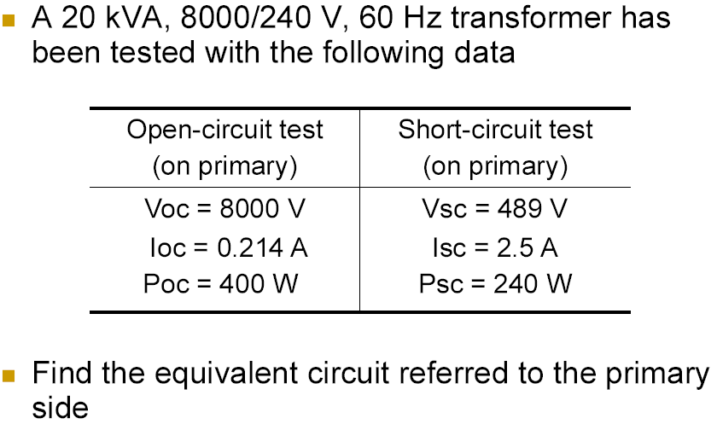
Determination of Equivalent Circuit
Example

Slide 16
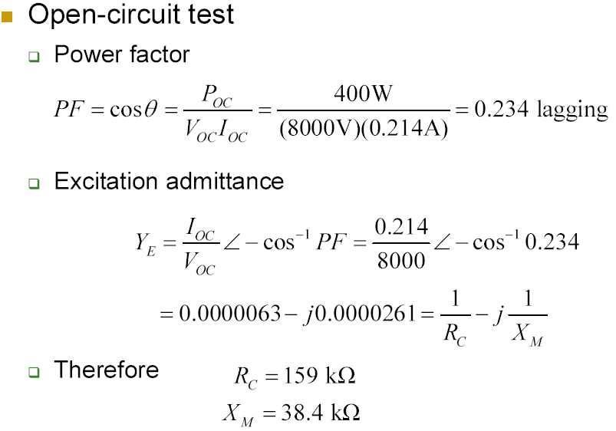
Determination of Equivalent Circuit
Example

Slide 17
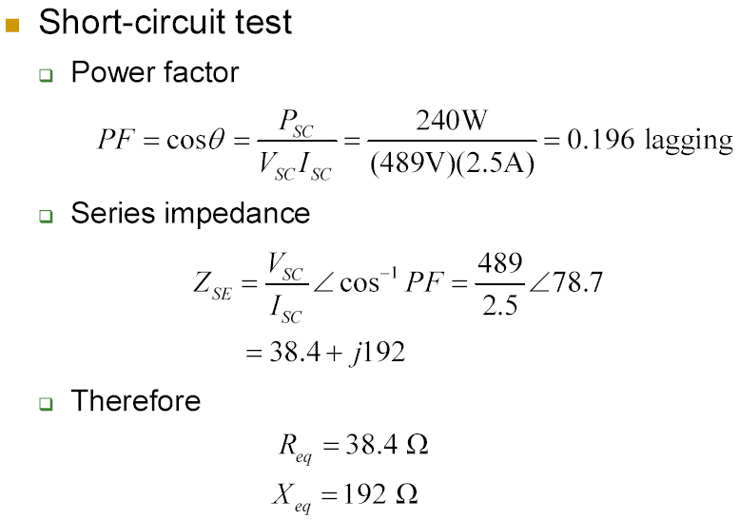
Determination of Equivalent Circuit
Example

Slide 18
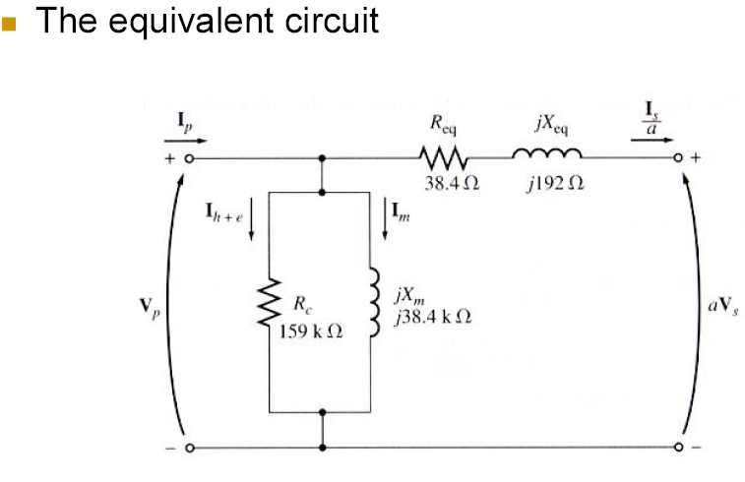
Determination of Equivalent Circuit
Example

